Slide 1
CIS:3370 Intrusion to Investigation
Part I
Chavez | Turner

Slide 2
User Story
On May 14, 2021, our team was alerted to an intrusion within our system, we as the digital forensics team, and we as the intrusion detection team, were requested to study the case, documented in the GitHub is our findings (Digital Forensics) and our solutions to prevent this from happening in the future (Intrusion Detection). The email was first sent to an employee on May 3^{rd,} which was an excel sheet with the macros for URSNIF. On May 14th another email was sent, that was similar in nature. URSNIF is more commonly referred to as a banking trojan. Originally identified in 2006, there was a GitHub leak of the source code for this trojan. Due to the recent event we, as the IDS team, will be working with the digital forensics team, not only find the root of the problem but also come together and create a solution so that this will not happen again.

Slide 3
Summary of the Project
For this project, we will be implementing an intrusion detection system, utilizing suricata. For this we will be implementing our own clauses into suricata, and from there creating a system that we can gather more information for further projects.
Notes:
Security Onion uses a Network-based IDS (NIDS) / Network Security Monitoring model, combining signature-based detection with Suricata and protocol/behavioral analysis with Zeek.

Slide 4
Scope
This project designs, implements, and documents an end-to-end workflow that uses Security Onion (Suricata + Zeek) and Wireshark-based digital forensics to detect, reconstruct, and analyze a malware infection in captured network traffic, then produce actionable IOCs, a case report, and a short live demo that shows how detection and investigation work together.

Slide 5
Materials
A system with Wireshark
VMware
Security Onion
Kali system run through the VM
https://www.malware-traffic-analysis.net/index.html
Private network, to be able to utilize security onion and its resources without anything blocking or interfering

Slide 6
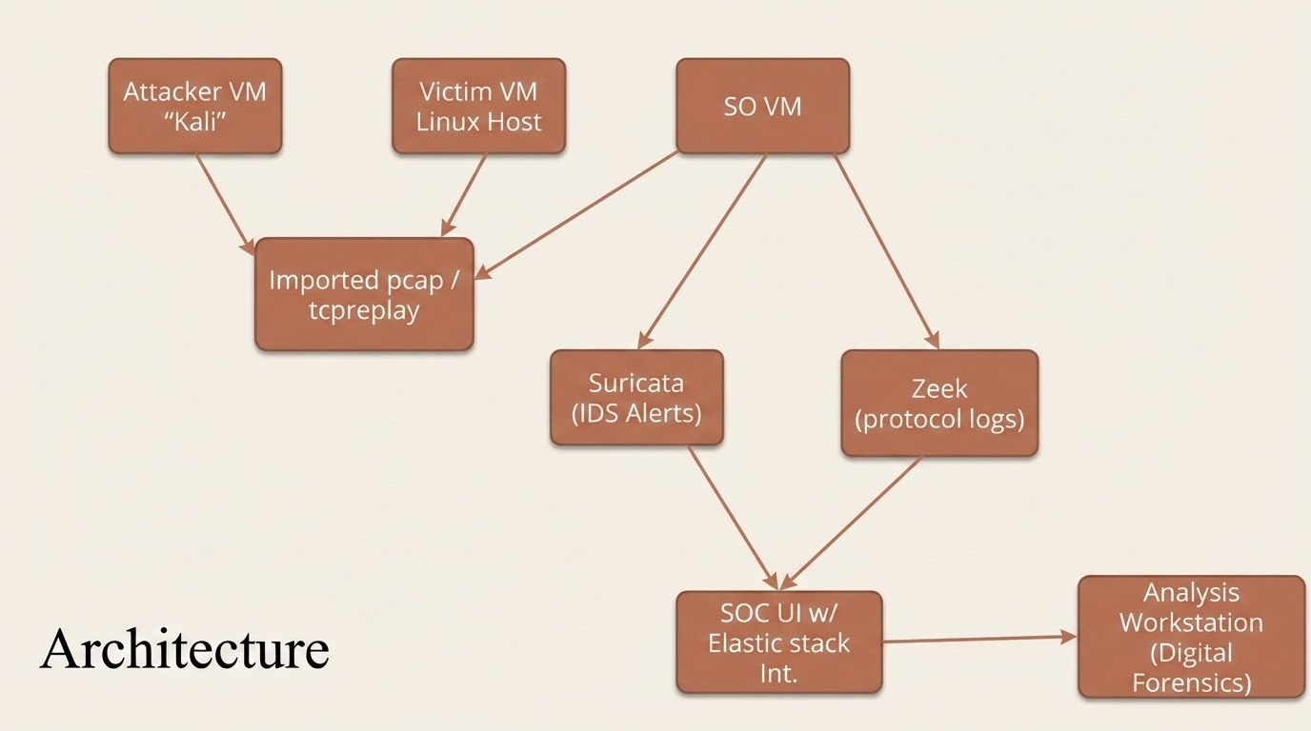

Slide 7
MILESTONES

Slide 8
Hunt runbook + tuning (suppressions/thresholds) + metrics.
Security Onion up, baseline & capture filters documented.
Future work
M1
M2
M3
M4
M5
Initial Suricata rule pack + Zeek logs validated.
Live detection demo + short tuning report.
IDS
Notes:
“Our goal on the IDS side was to stand up Security Onion, generate both normal and attack traffic, and prove that we could:
see the traffic,
detect attacks with Suricata, and
investigate them using Zeek and the Hunt interface.”
“The Digital Forensics part is a separate presentation that picks up later with the same PCAPs and IOCs. Here I’m focusing on how we detected and hunted the activity in the first place.”

Slide 9
(Optional) Memory/Disk triage and correlation to PCAP.
Case scope, chain-of-custody.
Future work
M1
M2
M3
M4
M5
Wireshark reconstruction + artifact extraction.
Final case report + IOC list + recommendations + demo.

Slide 10
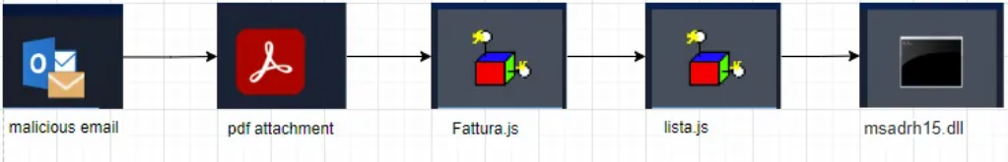
Initial Attack
The email was first sent to an employee on May 3^{rd,} which was an excel sheet with the macros for URSNIF. On May 14th another email was sent, that was similar in nature. URSNIF is more commonly referred to as a banking trojan. Originally identified in 2006, there was a GitHub leak of the source code for this trojan. Trojan Path is as follows:

Slide 11
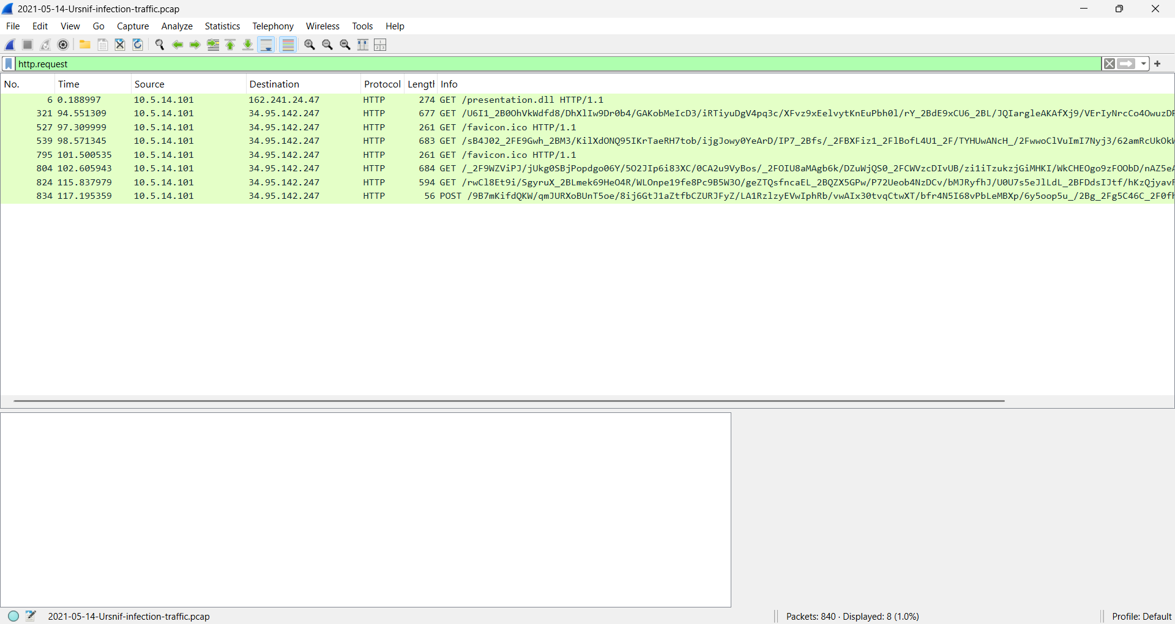
Wireshark Analysis of Pcap file

Slide 12
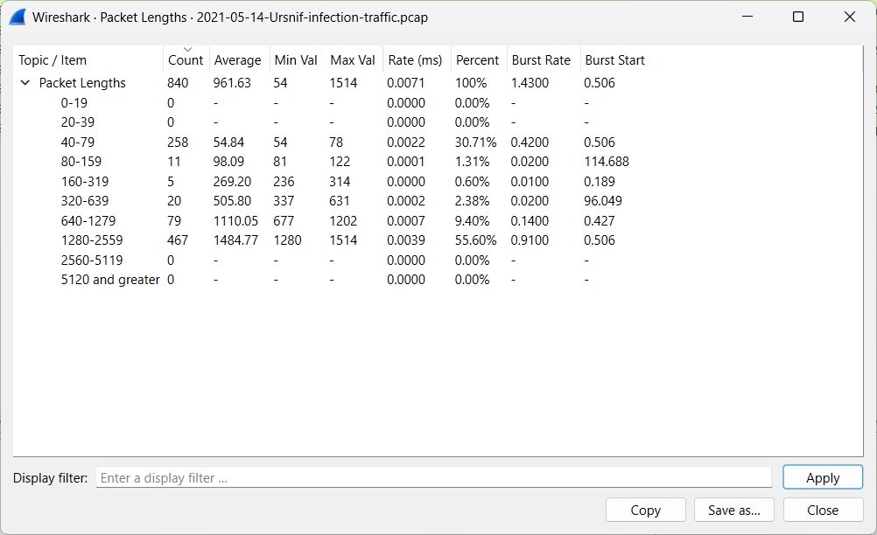
Wireshark Analysis of Pcap File

Slide 13
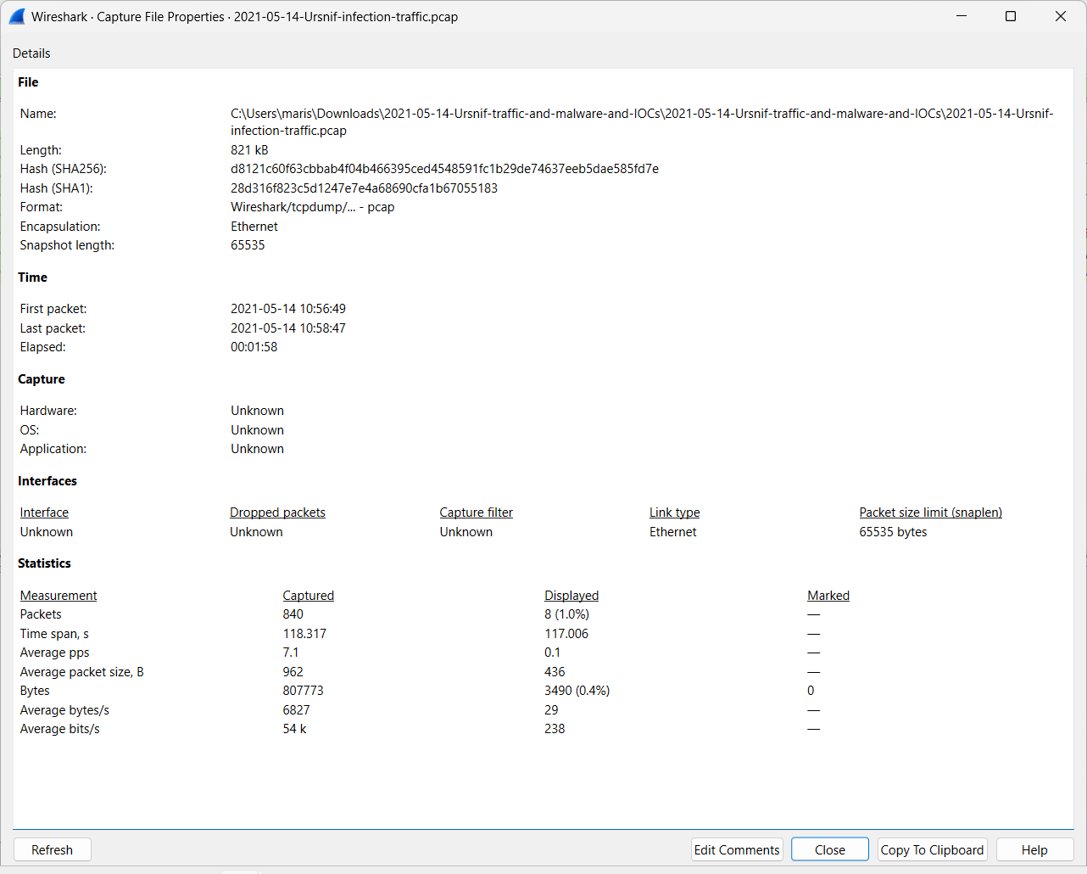
Wireshark Statistics (Filtered)

Slide 14
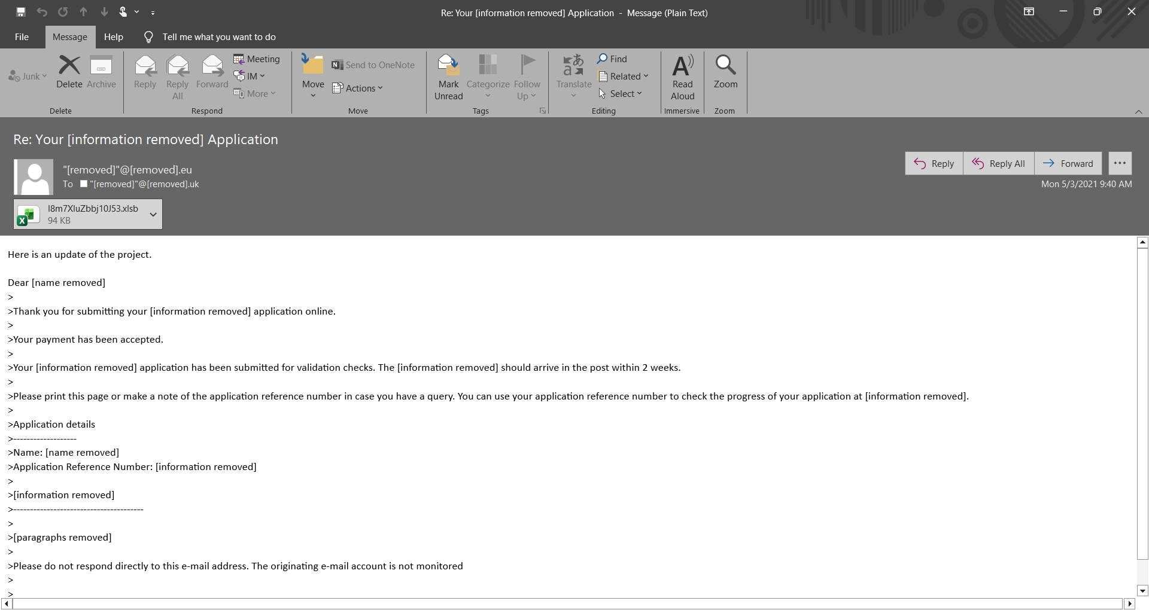
Original Phishing email

Slide 15
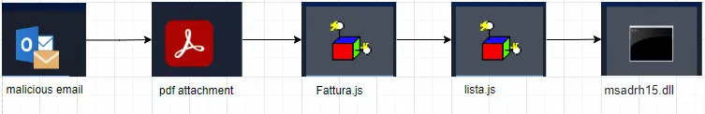
Ursnif, the banking trojan
Ursnif is a variant of the GOZI malware, usually disguises itself as a part of an invoice, was first seen in 2006, but had its script leaked in 2015, making it more accessible to other. So now it has a github:
https://github.com/MBCProject/mbc-markdown/blob/main/xample-malware/ursnif.md

Slide 16

Milestone 1 - Security Onion, Baseline & capture
Environment online
  Security Onion
  Kali
Monitor using SO
Gathering baseline traffic
Capture Filters

Slide 17
M1 – Environment online and monitoring
NIC/bridge configuration in Security Onion. See Figure 1.
Confirmed the sensor was actually seeing traffic from the lab network. See Figure 2.
Notes:
“Once we knew Security Onion could see the network, we had to understand what normal looked like.”
“We captured a baseline of traffic with no deliberate attacks: just normal browsing and system activity.”
“The File_Cap_Prop.png screenshot shows our capture configuration. We documented the capture filter so we weren’t grabbing random noise from outside the lab—only the subnet and ports we cared about.”
“The hunt-initial-logs.png image is from the Hunt interface with Zeek logs. This is our ‘before attacks’ view: mostly routine TCP connections and some basic HTTP.
That gave us a reference point so later, when Suricata started alerting, we could compare it against this baseline and see what really stood out.”

Slide 18
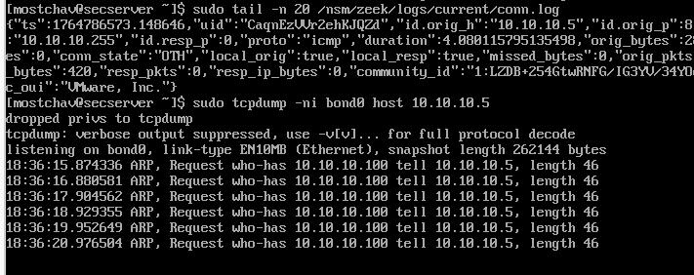
M1-Figure 1

Slide 19
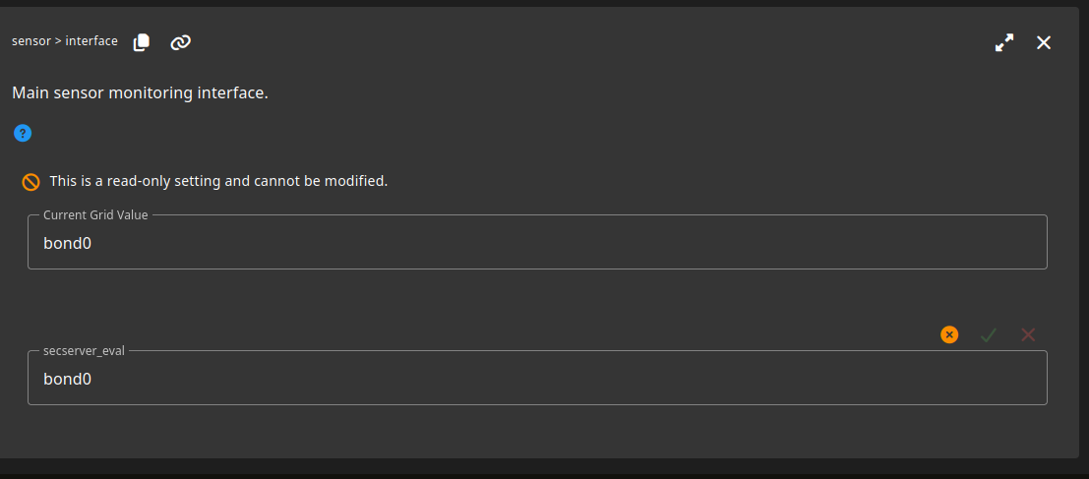
M1- Figure 2

Slide 20
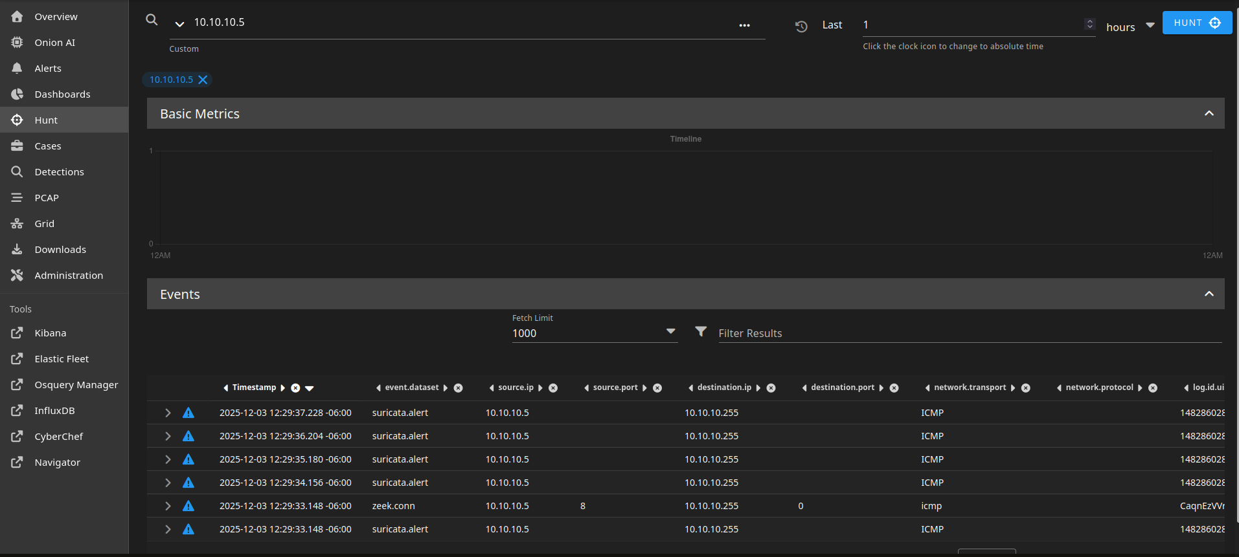
M1 – Baseline traffic + capture filters
Collected baseline traffic (normal browsing / no attacks).
Documented capture filter used (e.g. “only monitor relevant lab subnet and necessary ports”).
Notes:
Talking points:
What you looked for in baseline: volumes, common protocols, normal port usage.

Slide 21

Milestone 2 - Rules + Zeek validation
Configure Suricata
Configure Zeek
Rule Packs
Notes:
“Milestone 2 was where the IDS really became more than a packet sniffer.”
“On the back end, Suricata is doing signature-based inspection, and Zeek is writing rich metadata logs. Our job was to write rules that would actually fire when we ran the attacks and then confirm in Zeek that the pattern matched what the rule described.”
“We did run into a ‘rule mismatch’ error at one point when enabling our rules, which forced us to clean up the rule file and re-load it. That’s another realistic step: rules don’t help if the engine refuses to load them.”

Slide 22
Milestone 2 - Rules + Zeek validation
Collected baseline traffic (normal browsing / no attacks).
Documented capture filter used (e.g. “only monitor relevant lab subnet and necessary ports”).

Slide 23
M2 – Suricata rule pack + Zeek validation
Wrote a small custom rule pack for three attacks:
Port scanning
HTTP attack pattern
SSH brute-force
Enabled and tested them in Security Onion.
Notes:
“We built a small custom Suricata rule pack to detect three specific behaviors we were going to generate:
TCP port scanning
Suspicious HTTP activity
SSH brute-force attempts”

Slide 24
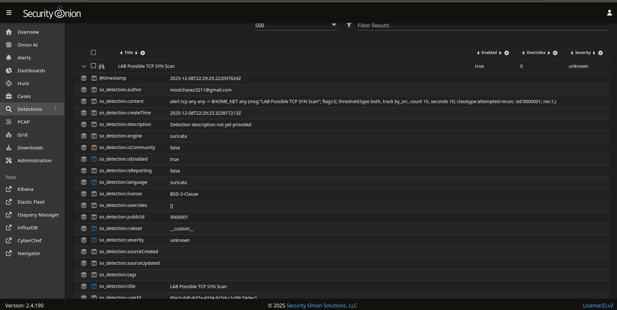
M2 - Port scan detection (Suricata + Zeek)
Notes:
“The first scenario was a port scan from the attacker host against the Security Onion IP.”
“We used a scanning tool to hit multiple TCP ports in a short time window. The idea behind the Suricata rule was:
‘If one source IP hits a lot of different ports on the same target quickly, raise an alert.’”
“M2_port_scan.png shows the alert in Security Onion that fired on this behavior. You can see the rule message we wrote and the source and destination information.”
“On the analysis side, we pivoted into Zeek’s conn.log and confirmed the pattern: a burst of short connections from the same attacker IP to many ports, which is exactly what you’d expect from a basic scan.”
“So by this point, we’ve proven: we can simulate a common recon technique and our IDS stack doesn’t just see it—it labels it in a way that an analyst can respond to.”

Slide 25
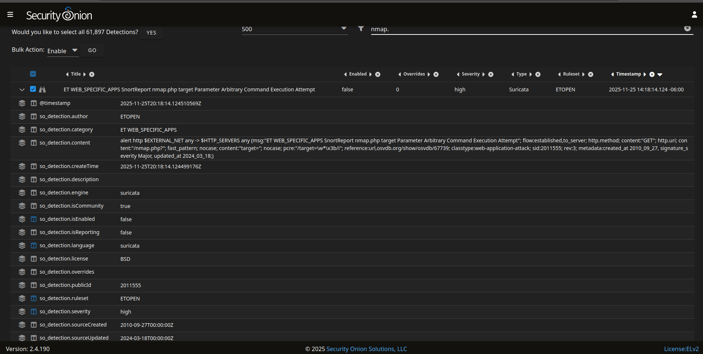
M2 - HTTP attack detection
Notes:
“Next we moved up the stack to HTTP attacks.”
“We generated suspicious HTTP traffic—requests that a normal user would not send—against a test web service. Examples included unusual URLs and repeated requests that looked more like probing than normal browsing.”
“HTTP_Attack.png shows Suricata raising an alert on that traffic. Again, we wrote the rule message ourselves so the alert is meaningful when it shows up in the console.”
“To validate and understand the context, we:
Looked at Zeek’s http.log to see hostnames, paths, and status codes.
“This demonstrates the workflow: IDS alert → Zeek logs for summary. That pattern is what real analysts do when they’re confirming whether an alert is noise or an actual attack.”

Slide 26
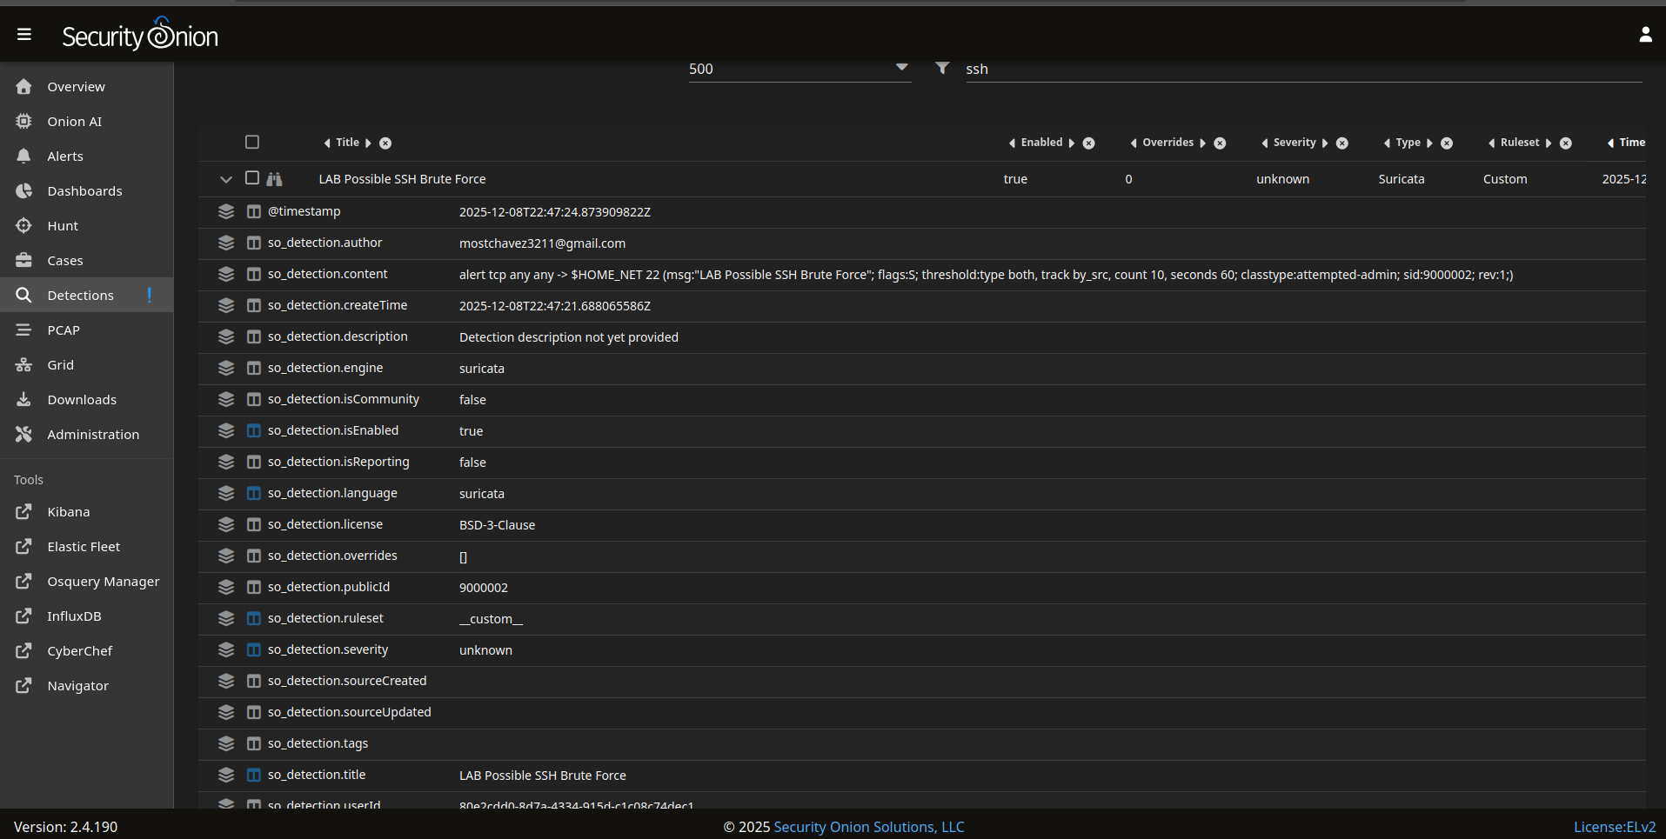
M2 - SSH brute-force detection
Notes:
“The last attack pattern in M2 was an SSH brute-force scenario.”
“We scripted repeated SSH attempts from the attacker host against port 22. In a real network you might see this from internet bots scraping SSH on every IP they find.”
“Our Suricata rule was based on the idea:
‘If there are many SSH connection attempts from the same source to the same destination within a short period, raise an alert.’”
“ssh_brutescan.png shows the alert firing in Security Onion.”
“We cross-checked that with Zeek logs to confirm that:
The same attacker IP tried multiple connections.
Most of them didn’t complete successfully, which aligns with brute-force behavior rather than a single login.”
“We also talked about tuning options here: for example, you might raise the threshold so admins don’t get paged for just two failed logins, but they still see a true brute-force burst.”

Slide 27
Milestone 3 – Hunt runbook, tuning, metrics
Create a Hunt runbook
Test and tune it
Gather metrics

Slide 28
M3 – Hunt runbook: from alert → decision
Start with a hypothesis or alert (e.g., “suspicious DNS,” “port scan”).
Triage in Security Onion: look at alert details, source/dest, rule message.
Pivot in Zeek logs: dns.log → conn.log → http.log, etc.
Enrichment: hostnames, GeoIP/IP reputation (even if just discussed, mention it).
Decision & documentation: benign vs malicious, note IOCs, note next actions.
Notes:
“Milestone 3 was about process, not just individual alerts.”
“We created a hunt runbook—basically a step-by-step playbook—for how to go from a suspicious signal to a documented decision. Our sections were:
Triage – Start from an alert or a hypothesis in Security Onion’s Alerts or Hunt views. Look at rule message, IPs, and ports.
Pivot in Zeek – Depending on the alert, jump into dns.log, conn.log, http.log, or ssh-related logs to see how broad the activity is.
Enrichment – Look up IP reputation or hostnames when needed, and correlate with what we know from the lab (for example, which IPs are Kali vs Security Onion).
Decision – Decide: benign, suspicious, or confirmed malicious.
Documentation – Record what we did, what we found, and any IOCs we want to keep.”
“We tested this runbook on our own PCAPs so that, if someone else sits down at the console, they can follow the same flow and reach similar conclusions.”

Slide 30
M3 – Tuning noisy rules + metrics
Suppressions
Thresholds
Notes:
“The other part of M3 was tuning and metrics.”
“We identified our top noisy rules and applied two main tuning techniques:
Suppressions – telling Suricata, ‘don’t alert if the source is this known lab scanner IP,’ because we use that host for testing all the time.
Thresholds – requiring a certain number of hits before raising an alert, so we only get notified for repeated behavior, not one-off packets.”

Slide 31
Milestone 4 – Malicious PCAP demo + takeaways
Malicious PCAP
IOCs
Takeaway
Notes:
“Milestone 4 combined everything: we imported a real malicious PCAP and treated it like an incident.”

Slide 32
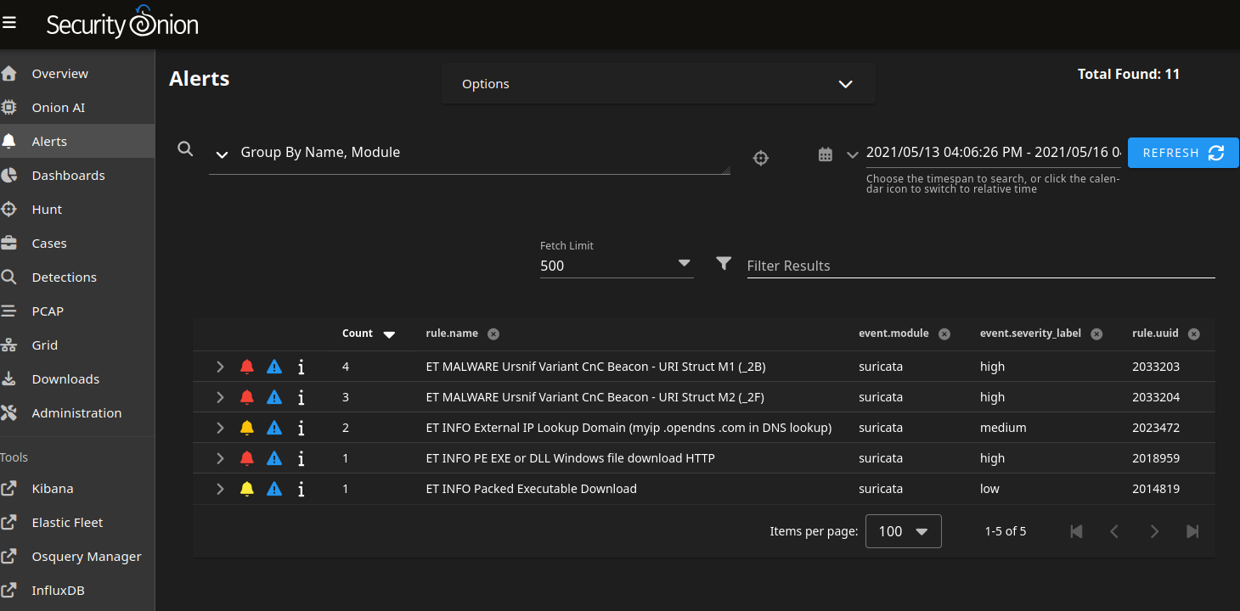
M4 – Malicious PCAP analysis and IOCs
Notes:
“We imported that PCAP into Security Onion and let Suricata and Zeek process it just like live traffic.”
“Alerts from Malicious PCAP.png shows some of the alerts that fired:
HTTP activity tied to the malicious campaign.
Indicators that looked like command-and-control or data exfiltration patterns.”
“From there we:
Pivotted into Zeek logs to identify all connections involving the victim.
Used Wireshark filters to look at the most suspicious streams.”
Note that these IOCs were then handed off to the DF side as part of the overall case.

Slide 33
Key Takeaways
Raw packets → baseline → rules → alerts → hunts → tuning
Biggest Technical Challenge:
  Networking/Visibility Issue
  Rule Mismatches
  Noisy Alerts
Notes:
The IDS side proves we can configure and operate a practical detection stack, not just click through dashboards, and it sets the stage for the forensic investigation that follows.

Slide 34
GITHUB
https://github.com/mwchavez/IDS_DF_F2025_Project_MC_MT_DP

Slide 35
Future Status of the project
Expand rule set
Automation (Training)
Notes:
Security Onion uses a Network-based IDS (NIDS) / Network Security Monitoring model, combining signature-based detection with Suricata and protocol/behavioral analysis with Zeek.

Slide 36
Resources used in gathering information
https://www.malware-traffic-analysis.net/2021/05/14/index.html
https://github.com/MBCProject/mbc-markdown/blob/main/xample-malware/ursnif.md
https://www.acronis.com/en/tru/posts/ursnif-the-banking-trojan/
https://attack.mitre.org/software/S0386/

Slide 37


